Slide 1
etl
Presented by: ugonma, Julia & chidima

Slide 2
Hotel reviews
Source: Kaggle & Datafiniti
Dataset: A list of 1,000 hotels & their online reviews

Slide 3
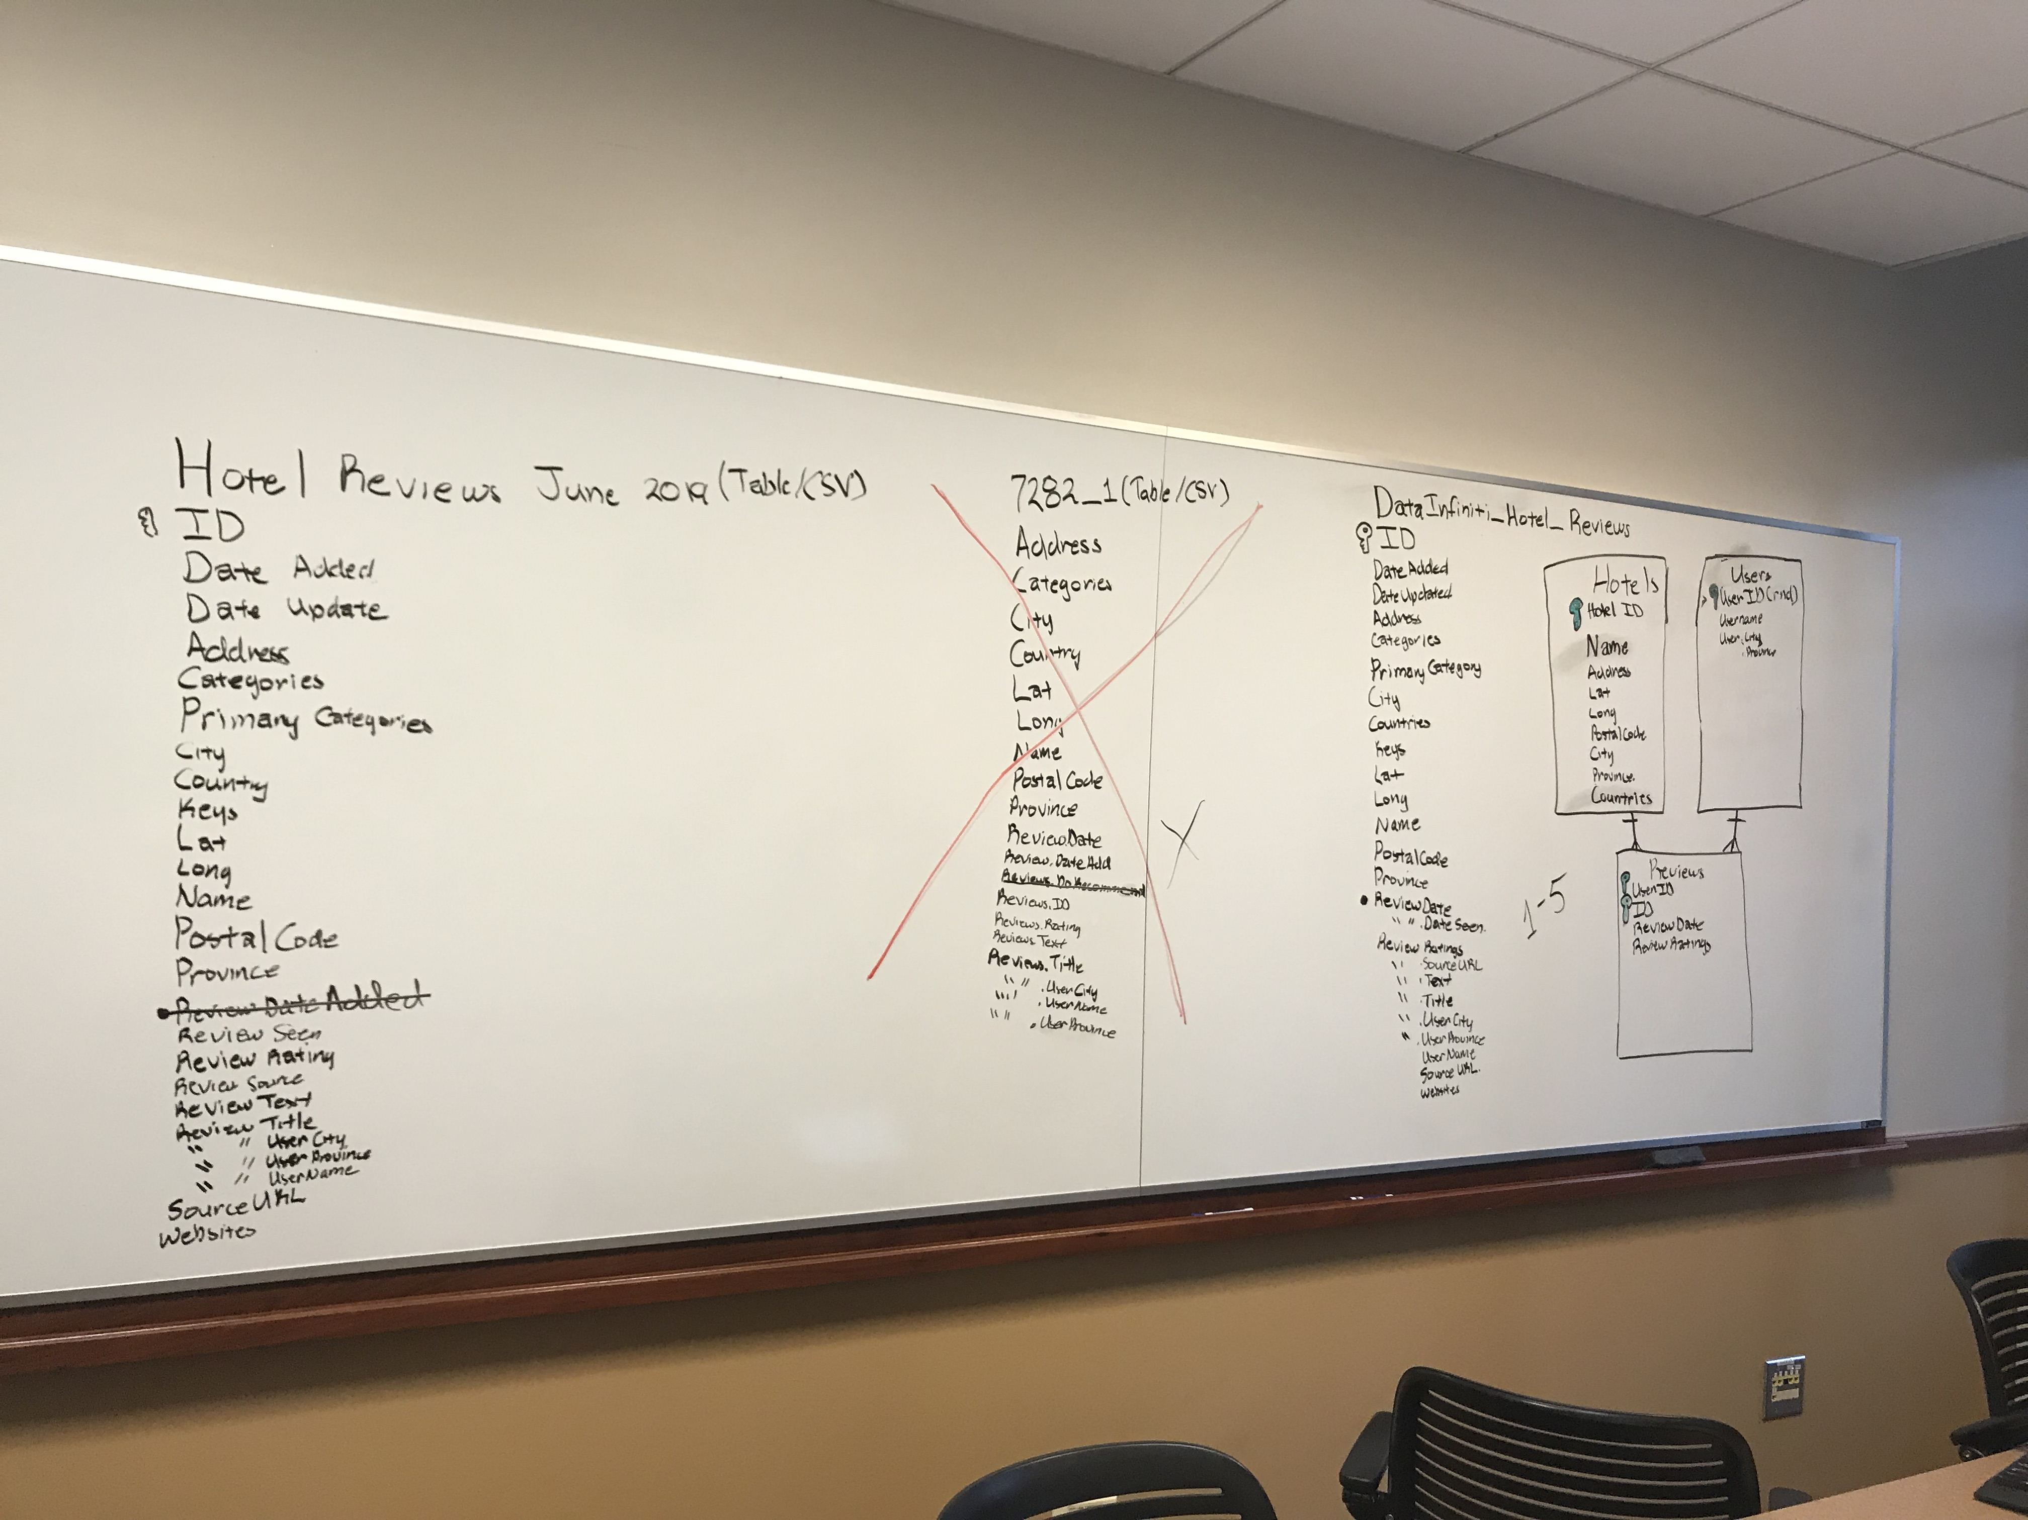
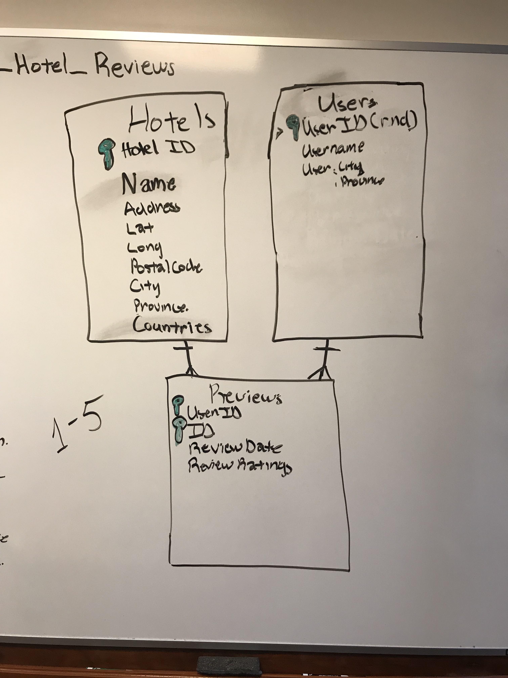
Data cleanup & analysis

Slide 4
Final Report
Extract :
CSV, Jupyter Notebook, pgAdmin 4, Pandas, sqlalchemy, & psycopg2
Transform:
Cleaning included renaming the column headers, used concat to join clean CSV’s and created 3 separate data frames that were loaded as empty tables into postgres.
Load:
Hotels, Users and Reviews were the final tables we chose because they are relational and we white boarded to show.
We were originally planning to create a bonus heat map to include but ran out of time.

